Slide 1


JSPM’s
Rajarshi Shahu College of Engineering, Tathawade, Pune
(An Autonomous Institute affiliated to Savitribai Phule Pune University)
Department of Computer Science and Business Systems
Academic Year: 2026–27 | Semester V
SKILL DEVELOPMENT LAB-II (SDL-II) • MINI PROJECT PRESENTATION
DeadlineBuddy
A Web-Based Deadline and Task Management System for Engineering Students
STUDENT DETAILS
• Student Name: Girish Sunil Hapse
• PRN / Roll No: RBT24CB067 | Roll No: CB-67
• Class & Branch: T.Y. B.Tech (Computer Science & Business Systems)
• Academic Term: Semester V (Academic Year 2026–27)
COURSE & FACULTY GUIDANCE
• Course Name: Skill Development Lab-II (SDL-II)
• Project Guide: Prof. Rutuja S. Bachhav
• Designation: Course Coordinator, Department of CSBS
• Presentation Date: 23 October 2026

Slide 2
Index
SKILL DEVELOPMENT LAB-II • AY 2026–27
[01] Introduction / Background
Academic domain context, student workload friction, and core motivation
[06] Technology & Tools Used
Jakarta EE 10, GlassFish 7.1.1, JPA EclipseLink, MySQL 8.0, and Bootstrap 5.3
[02] Problem Definition & Objectives
Task fragmentation, lack of academic taxonomy, and 5 measurable goals
[07] Implementation & Results
Core functional modules, UI dashboard, and 264/264 automated QA assertions
[03] Literature Survey & Gap Analysis
Evaluation of to-do apps, calendars, institutional LMS, and 4 critical gaps
[08] Conclusion & Future Scope
Key technical achievements, current limitations, and prospective roadmap
[04] Feasibility Study
Comprehensive Technical, Financial / Business, and Operational feasibility
[09] References
Standard IEEE citations, enterprise specifications, and technical whitepapers
[05] System Design & Architecture
3-Tier MVC architecture, data flow cycle, and relational DB isolation

Slide 3
Introduction / Background
SKILL DEVELOPMENT LAB-II • AY 2026–27
DEFINITION & EXECUTIVE OVERVIEW
DeadlineBuddy is a secure, high-performance web-based deadline and task management platform built on Jakarta EE 10. It is engineered specifically for engineering students to eliminate deadline amnesia, unify fragmented submission notices, and track course-wise academic deliverables.
INTRODUCTION & DOMAIN CONTEXT
• High Academic Load: Engineering curricula require managing 5–6 theoretical subjects alongside 3–4 practical laboratories per semester.
• 15–20 Concurrent Milestones: During peak mid-term and end-term weeks, students balance 15 to 20 overlapping deadlines (assignments, lab journals, seminars, project reviews).
• Channel Fragmentation: Milestones are scattered haphazardly across unofficial WhatsApp groups, college LMS portals, Discord servers, and physical lab notice boards.
• Cognitive Fatigue & Amnesia: Students lack a centralized schedule, leading to forgotten deadlines, late submission grade penalties, and acute academic distress.
• Evolution from Paper to Web: Manual paper diaries get lost; generic phone to-do apps lack academic course structures. An academic-aware relational web portal is essential.
CORE MOTIVATION IN TODAY'S TECH LANDSCAPE
• Enterprise Java Relevance: Demonstrates production-ready enterprise software engineering using Jakarta EE 10, Java Servlets 6.0, JPA 3.1, and MySQL 8.0.
• Academic Self-Regulation: Provides instant temporal feedback (Overdue, Due Today, Upcoming), fostering student accountability, structured study routines, and improved CGPA.
• Relational Academic Model: Uniquely models the natural educational hierarchy: Student → Subject → Task Type (Assignment vs Practical vs Submission vs Exam).
• Defensive Security Standard: Protects student data with OWASP-grade defenses: PBKDF2 hashing (210,000 iterations), CSRF tokens, and database composite foreign keys.
• Lightweight & Zero-Bloat: Leverages native server-side rendering (JSP/JSTL + Bootstrap 5.3) for lightning-fast sub-40ms loads without complex client build tools.

Slide 4
Problem Definition & Objectives
SKILL DEVELOPMENT LAB-II • AY 2026–27
PROBLEM DEFINITION (THE ACADEMIC BOTTLENECKS)
1. Announcement Dispersion: Critical submission dates are buried within fast-moving chat groups, emails, and physical lab notices, causing students to overlook deadlines.
2. Lack of Academic Categorization: Generic productivity tools treat all tasks identically, failing to distinguish a minor homework assignment from a heavy final practical submission.
3. Silent Deadline Expiry: Digital calendars allow deadlines to silently pass without actively highlighting overdue submission debt or showing subject completion progress.
4. Security Vulnerabilities in Student Apps: Most student-built portals rely on plaintext or unsalted MD5 passwords, lack CSRF token protection, and suffer from cross-user data leakage.
5. Client-Side Framework Bloat: Modern SPAs introduce heavy npm dependencies and slow bundle parsing on entry-level student smartphones and laptops.
PROJECT OBJECTIVES (TECHNICAL GOALS)
• Objective 1 — Multi-Tier Enterprise Architecture: Design and deploy a 3-tier MVC architecture on Jakarta EE 10, Java Servlets, JSP/JSTL, and JPA EclipseLink on Eclipse GlassFish 7.1.1.
• Objective 2 — Dynamic Temporal State Engine: Automatically classify tasks into Overdue, Due Today, Upcoming (within 7 days), and Completed based on real-time server timestamp evaluations.
• Objective 3 — Subject Portfolio & Progress Tracking: Provide personalized course management with hex color coding and visual progress bars showing subject-wise completion percentages.
• Objective 4 — Defense-in-Depth Security: Enforce PBKDF2-HMAC-SHA256 password hashing (210,000 rounds), anti-CSRF token verification, session regeneration, and composite foreign key isolation.
• Objective 5 — Empirical QA Validation: Verify 100% reliability and zero regression across all routes using an automated HTTP test suite with 264 passing test assertions.

Slide 5
Literature Survey & Gap Analysis
SKILL DEVELOPMENT LAB-II • AY 2026–27
Commercial To-Do Apps (Todoist, Any.do, TickTick)
• Strengths: Sleek mobile/desktop UI, cross-device sync, general tags.
• Limitations: Expensive subscriptions for reminders; treats tasks as flat personal chores; no academic deliverable types or course completion bars.
Digital Calendar Systems (Google Calendar, Outlook)
• Strengths: Fixed time-slot scheduling, recurring alarms, meeting invites.
• Limitations: Events expire and disappear into history; no deliverable state machine (Pending → In Progress → Done); no priority queuing.
Institutional LMS (Moodle, Blackboard, Classroom)
• Strengths: Official syllabus repository, teacher announcements, formal grading.
• Limitations: Strictly teacher-driven; cannot record personal study schedules, peer tasks, or offline homework; cluttered and non-responsive mobile UI.
IDENTIFIED RESEARCH & TECHNICAL GAPS (ADDRESSED BY DEADLINEBUDDY)
• Gap 1: Absence of Academic Taxonomy — Existing tools lack the relational hierarchy: Student → Subject → Task Type (Assignment, Practical, Submission, Exam, Other). DeadlineBuddy models this natively.
• Gap 2: Missing Real-Time Overdue & Progress Metrics — Commercial tools lack dynamic temporal categorization (Overdue, Due Today, Upcoming) alongside visual subject-level completion progress bars.
• Gap 3: Security & Multi-Tenant Vulnerabilities — Student portals frequently suffer from unsalted passwords, CSRF exploits, and missing cross-user data isolation. DeadlineBuddy enforces PBKDF2 and composite foreign keys.
• Gap 4: Client-Side Framework Bloat — Heavy single-page apps suffer from high latency on low-end hardware. DeadlineBuddy uses zero-build server rendering for sub-40ms performance.

Slide 6
Feasibility Study
SKILL DEVELOPMENT LAB-II • AY 2026–27
1. TECHNICAL FEASIBILITY
• Proven Enterprise Stack: Built on battle-tested Jakarta EE 10 standards, Java 17 LTS, and Eclipse GlassFish 7.1.1 application server.
• Robust Persistence: JPA 3.1 (EclipseLink) over MySQL 8.0 InnoDB provides full ACID transactional guarantees, connection pooling, and schema constraints.
• Multi-Tenant Isolation: MySQL composite foreign key `(subject_id, user_id)` guarantees row-level data isolation directly at the database engine level.
• High Performance: Sub-40ms response times with zero client-side compilation; fully responsive across mobile (375px) and desktop (1280px+).
• Technical Verdict: HIGHLY FEASIBLE — Standardized Java ecosystem ensures high maintainability and long-term stability.
2. FINANCIAL / BUSINESS
• 100% Open-Source Stack: Developed entirely with free, open-source technologies (Azul Zulu OpenJDK, MySQL Community, GlassFish, NetBeans, Bootstrap 5.3).
• Zero Licensing Overhead: ₹0 software licensing or recurring subscription costs; no cloud vendor lock-in or proprietary runtime dependencies.
• Minimal Hardware Footprint: Runs efficiently on existing college servers or low-cost virtual machines without requiring specialized GPU/AI hardware.
• High Educational ROI: Prevents missed submission penalties, protects student semester CGPAs, and saves faculty significant administrative follow-up time.
• Financial Verdict: HIGHLY FEASIBLE — Maximum institutional productivity value with zero financial expenditure.
3. OPERATIONAL FEASIBILITY
• Zero Client Installation: 100% browser-based; accessible immediately from any smartphone, tablet, or PC without downloading app store packages.
• Intuitive User Ergonomics: Clean visual dashboard with immediate color-coded alert tiles (Overdue in Red, Due Today in Amber); requires zero student training.
• Privacy & Compliance: Strict session regeneration and OWASP-aligned cryptographic controls ensure student academic privacy is fully preserved.
• Automated QA Assurance: Proven 100% test pass rate across 264 HTTP assertions, guaranteeing robust zero-crash operational stability.
• Operational Verdict: HIGHLY FEASIBLE — Ready for seamless deployment across department lab environments.

Slide 7
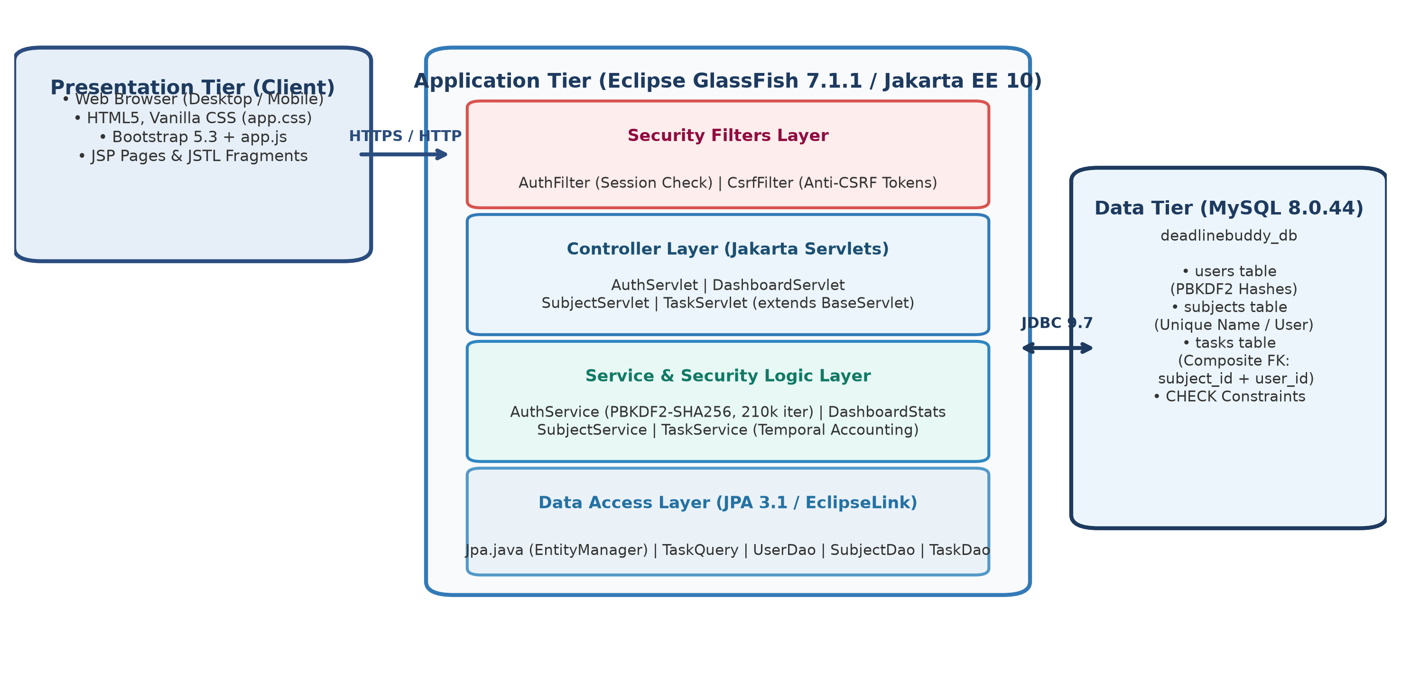
System Design & Architecture
SKILL DEVELOPMENT LAB-II • AY 2026–27
Tier 1: Presentation Tier (JSP 3.1 & JSTL 3.0)
Renders responsive Bootstrap 5.3 UI. Automatically injects hidden CSRF tokens into all POST forms; zero client build step.
Tier 2: Web & Security Filter Tier (Jakarta Servlets 6.0 & Filters)
AuthFilter protects private routes; CsrfFilter validates synchronized anti-CSRF tokens; Passwords.java manages PBKDF2 hashing.
Tier 3: Business Logic Tier (TaskService & SubjectService)
Calculates temporal task states (Overdue / Due Today / Upcoming); aggregates subject completion ratios; validates input bounds.
Figure: Multi-Tier MVC Architecture of DeadlineBuddy on Jakarta EE 10
DATABASE COMPOSITE KEY MULTI-TENANT ISOLATION
• Composite Foreign Key: FOREIGN KEY (subject_id, user_id) REFERENCES subjects (id, user_id)
• Engine-Level Defense: Guarantees that a task can only point to a subject owned by the SAME user. Even if application code were compromised, MySQL rejects unauthorized cross-user modifications.
Tier 4: Persistence & Database (JPA 3.1 EclipseLink & MySQL 8.0)
DAO layer manages relational entities with JDBC connection pooling. MySQL 8.0 InnoDB engine ensures ACID compliance.

Slide 8
Technology & Tools Used
SKILL DEVELOPMENT LAB-II • AY 2026–27
ENTERPRISE PLATFORM & BACKEND
• Java Platform: Java 17 LTS bytecode (Built on Azul Zulu OpenJDK 25)
• Enterprise Standard: Jakarta EE 10 Web Profile Specification
• Web Controller Layer: Jakarta Servlets 6.0 (`jakarta.servlet.http.*`)
• Server-Side Rendering: Jakarta Server Pages (JSP 3.1) & JSTL 3.0 Standard Tag Library
APPLICATION SERVER & DATABASE
• Application Server: Eclipse GlassFish 7.1.1 (Deployed under `/DeadlineBuddy`)
• Database Engine: MySQL Server 8.0.44 (InnoDB Storage Engine with ACID)
• Persistence / ORM: Jakarta Persistence (JPA 3.1) via EclipseLink implementation
• Database Driver: MySQL Connector/J 9.7.0 (JDBC Connection Pooling)
DEFENSIVE SECURITY & ENCRYPTION
• Password Cryptography: PBKDF2-HMAC-SHA256 (210,000 iterations, 16-byte salt, constant-time compare)
• CSRF Defense Filter: Synchronized Token Pattern (`CsrfFilter`) on all HTTP state changes
• Session Fixation Defense: Fresh session ID issued upon sign-in; strict session invalidation on logout
• SQL Injection Prevention: 100% Prepared Statements and parameterized JPA queries
FRONTEND, IDE & QUALITY ASSURANCE
• Frontend & Responsive UI: Bootstrap 5.3, HTML5, Vanilla CSS3 (Zero npm/webpack bloat)
• Development IDE: Apache NetBeans 30 (Ant-based Java Web Application)
• Build System: Apache Ant (Automated Clean, Compile & WAR packaging)
• Quality Assurance Suite: Automated HTTP regression suite (264 assertions across 7 batches)

Slide 9
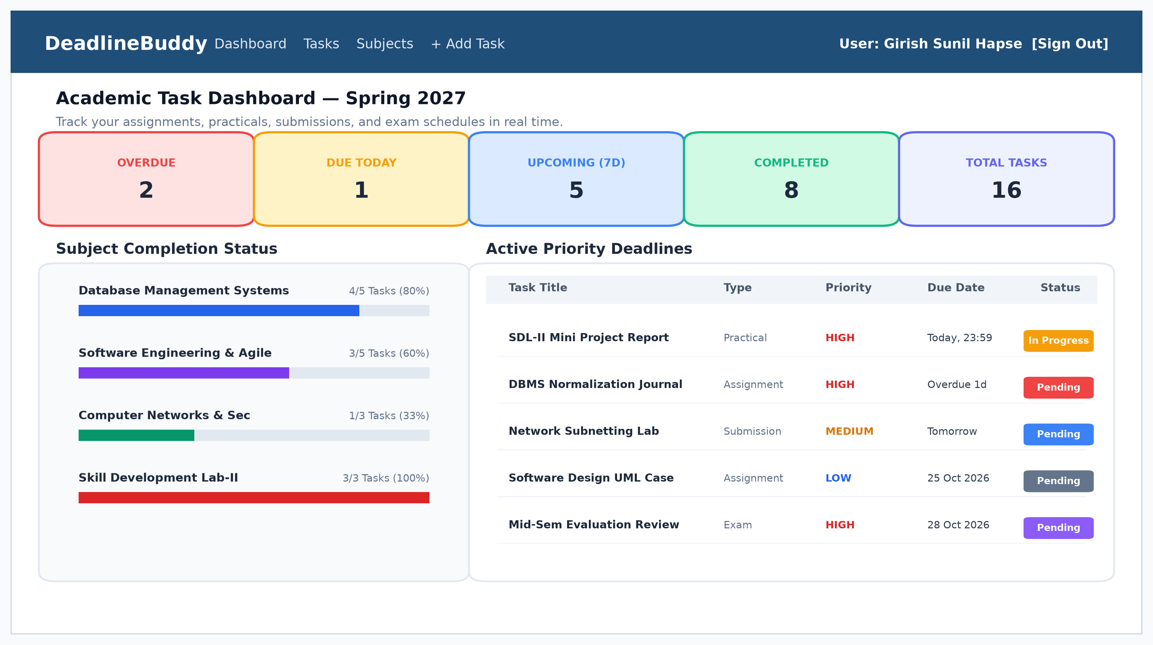
Implementation & Results
SKILL DEVELOPMENT LAB-II • AY 2026–27
CORE FUNCTIONAL MODULES IMPLEMENTED
1. Auth & Session Management: User registration, PBKDF2 hashing, session regeneration, and automated login redirect safeguards.
2. Subject Management & Progress: Student-owned subject portfolio with personalized hex colors, duplicate name prevention, and live task completion progress bars.
3. Task Scheduling & Query Engine: Full CRUD across 5 academic types (Assignment, Practical, Submission, Exam, Other) with 3 priority tiers and dynamic multi-criteria search/filter.
4. Real-Time Dashboard Analytics: Six dynamic KPI tally cards (Total, Completed, Pending, In Progress, Overdue, Due Today) with priority-focused work queues.
5. Defensive Security Layer: Global AuthFilter protecting private routes; CsrfFilter blocking unauthorized cross-origin state changes; composite keys blocking IDOR attacks.
Figure: DeadlineBuddy Running Dashboard with KPI Cards & Task Matrix
264 / 264 Passed
100% Test Assertions
Across 7 automated test batches
466 Pages Crawled
Zero HTTP Errors
Crawled across 3 concurrent users
< 40 ms Latency
Ultra-Fast Server Loads
Sub-40ms page delivery on GlassFish
100% Data Integrity
Zero Server Leakage
Persistent across full GlassFish restarts

Slide 10
Conclusion & Future Scope
SKILL DEVELOPMENT LAB-II • AY 2026–27
SUMMARY OF TECHNICAL ACHIEVEMENTS
• Successful Enterprise Deployment: Engineered and validated DeadlineBuddy on Jakarta EE 10, Java Servlets 6.0, JPA 3.1 EclipseLink, and MySQL 8.0 hosted on Eclipse GlassFish 7.1.1.
• Elimination of Academic Amnesia: Directly solved student submission bottlenecks through real-time temporal state classification (Overdue, Due Today, Upcoming, Completed) and subject completion bars.
• Production-Grade Security: Enforced OWASP defenses with PBKDF2 password derivation (210,000 rounds), CSRF token validation, session regeneration, and composite foreign key database isolation.
• Empirical Verification: Attained a 100% pass rate across 264 automated QA test assertions and 466 crawled pages with zero runtime errors.
CURRENT SYSTEM LIMITATIONS
• In-Application Alerts Only: Deadlines are displayed visually via real-time dashboard tally cards and badges; automated outbound SMS/email gateways are not yet connected.
• Offline Mode Absence: Application delivers an ultra-responsive web experience on mobile and desktop, but does not yet feature Progressive Web App (PWA) offline service workers.
• Manual Coursework Entry: Students manually enter tasks; bi-directional RESTful synchronization with college LMS (Moodle / Google Classroom) is not yet integrated.
FUTURE SCOPE & DEVELOPMENT ROADMAP
• Outbound Alert Gateways: Integrate JavaMail API and WebPush notifications to dispatch automatic reminders 24 hours and 2 hours prior to scheduled deadlines.
• Institutional LMS Sync: Develop RESTful API connectors for Moodle, Canvas, and Google Classroom to automatically ingest college assignments and lab notices.
• AI-Driven Workload Balancer: Incorporate heuristic scheduling algorithms that analyze estimated effort, priority, and exam timetables to suggest balanced daily study plans.

Slide 11
References
SKILL DEVELOPMENT LAB-II • AY 2026–27
STANDARD IEEE & TECHNICAL CITATIONS
[1] Eclipse Foundation, "Jakarta EE 10 Web Profile Specification, Eclipse Foundation Standards, Doc ID: JEE-10-SPEC, 2023. [Online]. Available: https://jakarta.ee/specifications/platform/10/"
[2] EclipseLink Project, "EclipseLink 3.1 Developer's Guide: Jakarta Persistence (JPA), Eclipse Foundation Documentation, 2024. [Online]. Available: https://www.eclipse.org/eclipselink/"
[3] Oracle Corporation, "MySQL 8.0 Reference Manual: InnoDB Engine Architecture and Optimization, Oracle Press, Redwood City, CA, 2024. [Online]. Available: https://dev.mysql.com/doc/"
[4] OWASP Foundation, "OWASP Top 10 Web Application Security Risks, Open Web Application Security Project Standards, 2021. [Online]. Available: https://owasp.org/Top10/"
[5] R. S. Pressman and B. R. Maxim, "Software Engineering: A Practitioner's Approach, 9th Edition, McGraw-Hill Higher Education, New York, NY, 2020, ISBN: 978-1259872976."
[6] A. Silberschatz, H. F. Korth, and S. Sudarshan, "Database System Concepts, 7th Edition, McGraw-Hill Higher Education, New York, NY, 2019, ISBN: 978-0078022159."
[7] National Institute of Standards and Technology (NIST), "Recommendation for Password-Based Key Derivation: PBKDF2, NIST Special Publication 800-132, U.S. Dept. of Commerce, 2010."
[8] Azul Systems, "Zulu OpenJDK 25 and 17 LTS Enterprise Compatibility Guide, Azul Systems Technical Whitepaper, 2024. [Online]. Available: https://www.azul.com/products/core/"
[9] Apache Software Foundation, "Apache NetBeans 30 & Apache Ant Build Management Documentation, 2024. [Online]. Available: https://netbeans.apache.org/"
[10] Mark Otto and Jacob Thornton, "Bootstrap 5.3: Responsive Front-End Framework Documentation, 2024. [Online]. Available: https://getbootstrap.com/"

Slide 12
Thank You!
Questions & Discussion Are Welcome
DeadlineBuddy – A Web-Based Deadline and Task Management System
Presented by: Girish Sunil Hapse (PRN: RBT24CB067 | Roll No: CB-67)
Under the Guidance of: Prof. Rutuja S. Bachhav (Course Coordinator & Guide)
Department of Computer Science and Business Systems
JSPM’s Rajarshi Shahu College of Engineering, Tathawade, Pune
Local Deployment: http://localhost:8080/DeadlineBuddy

